Slide 1
Amazon Product Review Sentiment Analysis
Lalit Jain: https://www.linkedin.com/in/lalit7jain
Big Data Systems & Analytics

Slide 2
Agenda
Case Study
Scraping reviews
Sentiment analysis
Classification using Doc2Vec (Logistic, SGD, SVM)
Challenges

Slide 3
Case Study
Scrape the reviews of any website and perform sentiment analysis on the corpus
Using sentiment analysis result, once the document is classified appropriately use it to perform classification algorithm using doc2vec approach (SVM/ Deep Belief Network)

Slide 4
Scraping Reviews
Programming Language used: R
Libraries required: Rvest, dplyr, tm, quanteda, etc
Approach:
From the main page of the product, navigate automatically to the review page
Loop through required number of pages to get the number of reviews required with an average of 10 reviews per page
Reviews need to be saved in the disk directly to save read only memory and take advantage of hard disk capacity
Note: Both the “page link” and the “number of pages” can be passed as an argument callable to the script

Slide 5
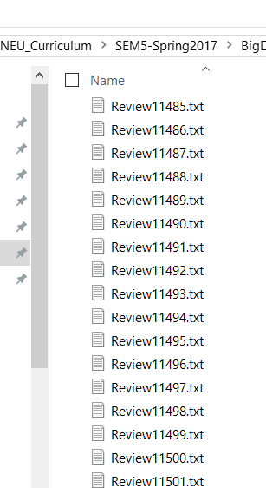
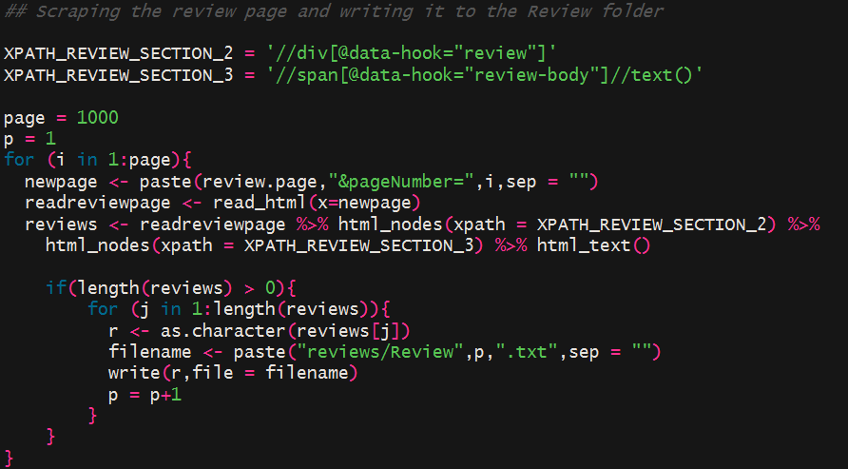
Results

Slide 6
Corpus Operations
Loading the documents using quanteda package
Quanteda will create Document Frequency Matrix by function dfm().
This function essentially does this by series of operation including tokenizing, lowercasing, indexing, stemming, matching with dictionary
Hu and Liu’s lexicon
Using list of positive and negative words (dictionary) available from Hu and Liu’s lexicon with more than 6700+ words
All operations in one line!

Slide 7
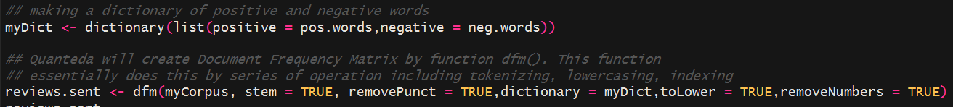
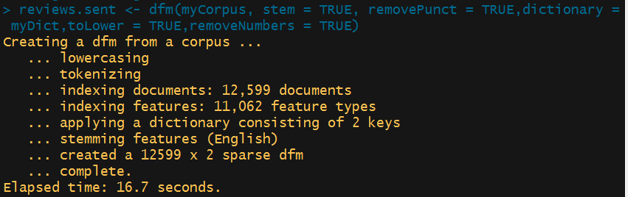
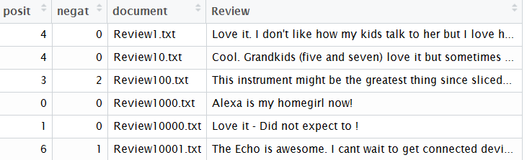
Result

Slide 8
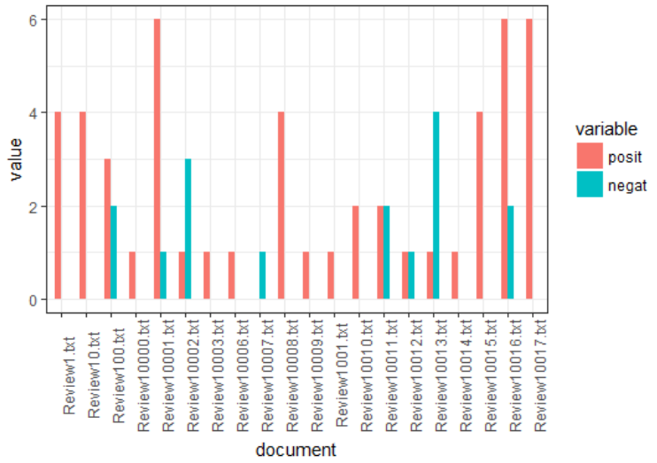
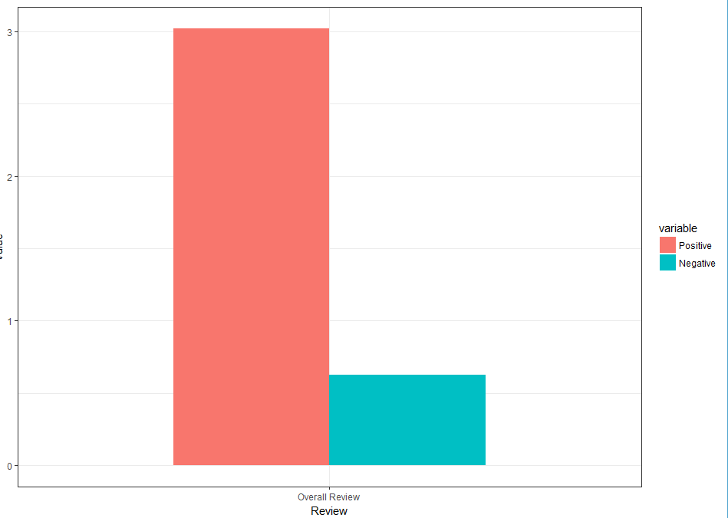
Visualizing the Sentiments

Slide 9
Classification
Programming Language used: Python
Libraries required: gensim, nltk, sklearn, etc.
Approach:
Load the raw reviews and apply cleaning using nltk package (stop words, stemming, numbers,etc)
Create TaggedDocuments required for building Doc2Vev models (both DM and DBOW)
Train both the model 10 times with random shuffling of the documents
Split the dataset and apply classification algorithms

Slide 10
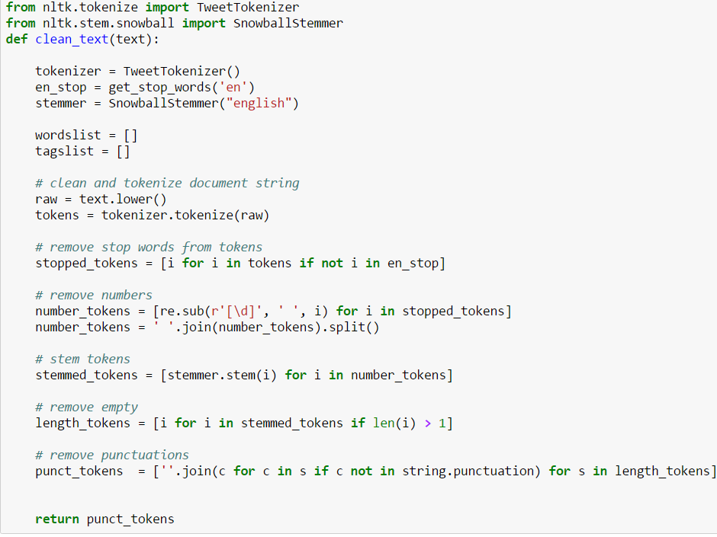
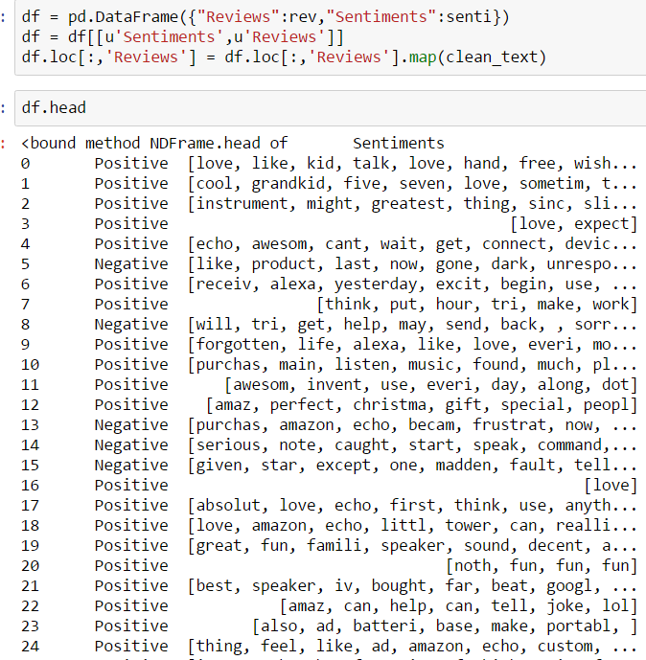
1) Cleaning the loaded documents

Slide 11
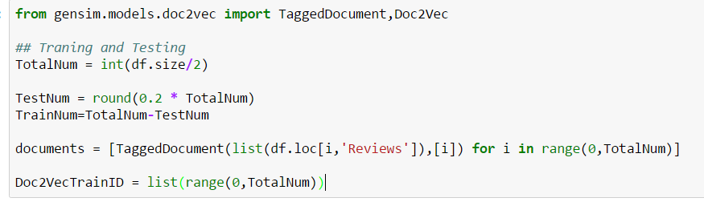
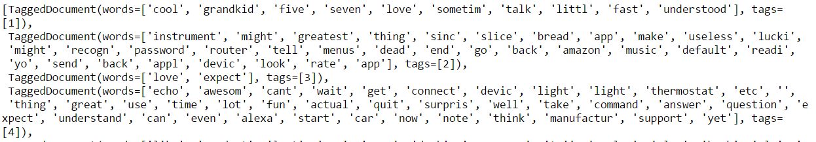
2) Create TaggedDocuments

Slide 12
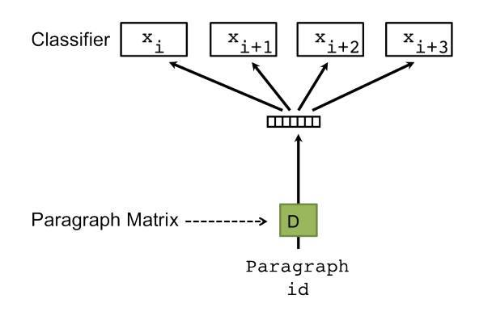
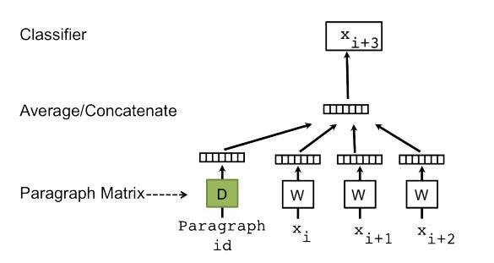
DM and DBOW models
dbow (distributed bag of words) It is a simpler model that ignores word order and training stage is quicker. The model uses no-local context/neighboring words in predictions
dm (distributed memory) We treat the paragraph as an extra word. Then it is concatenated/averaged with local context word vectors when making predictions. During training, both paragraph and word embeddings are updated. It calls for more computation and complexity.

Slide 13
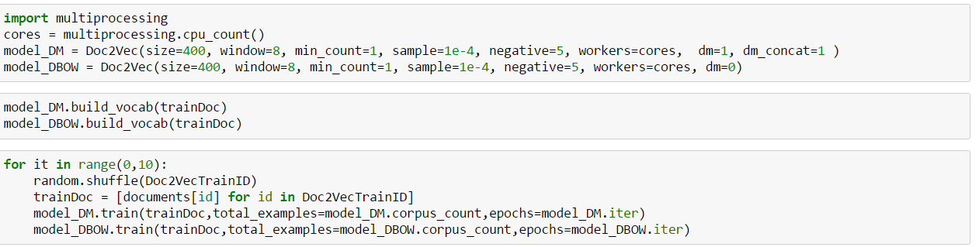
3) Training the model

Slide 14
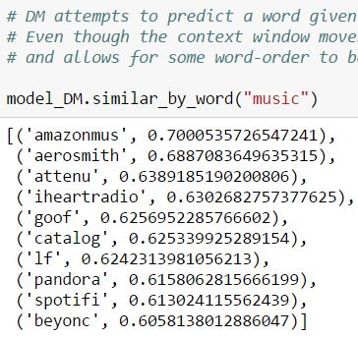
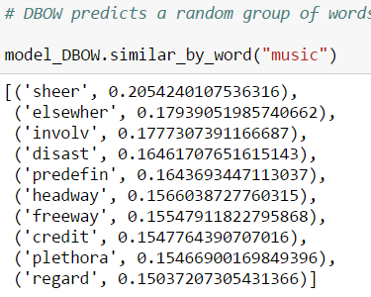
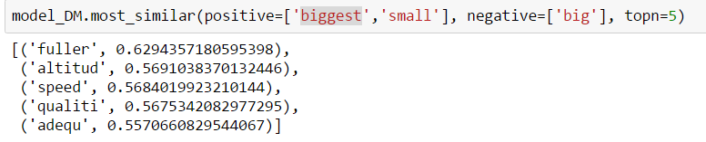
Checking the arrangements of Word vectors by both models

Slide 15
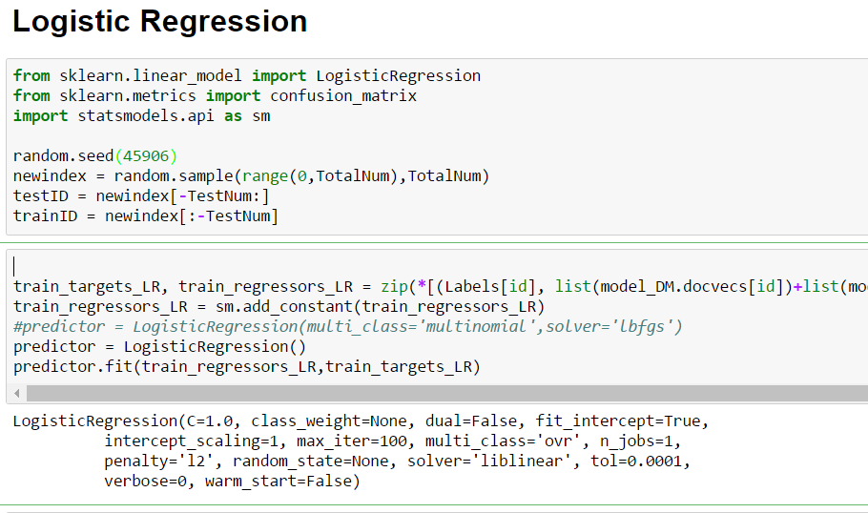
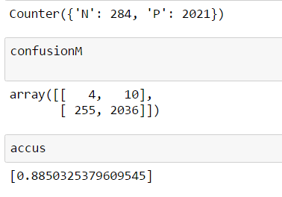
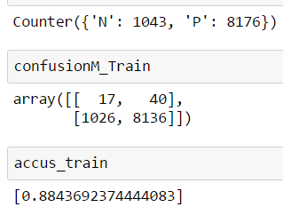
4) Applying Classification Algorithm
Testing
Training

Slide 16
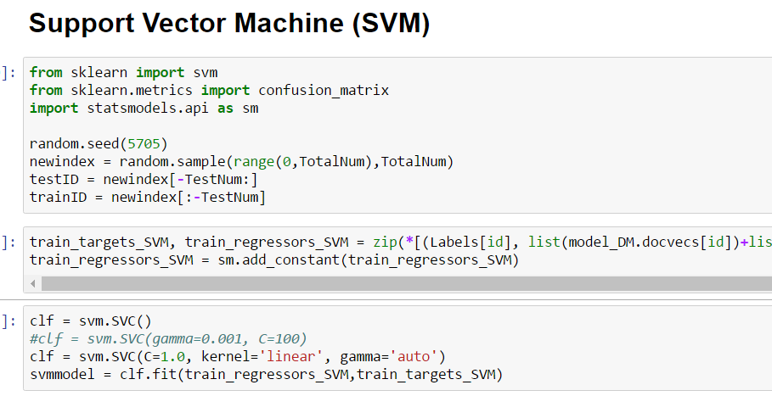
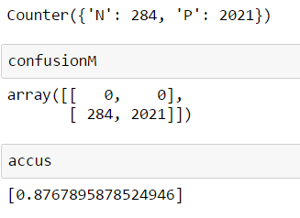
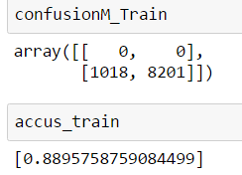
4) Applying Classification Algorithm
Testing
Training

Slide 17
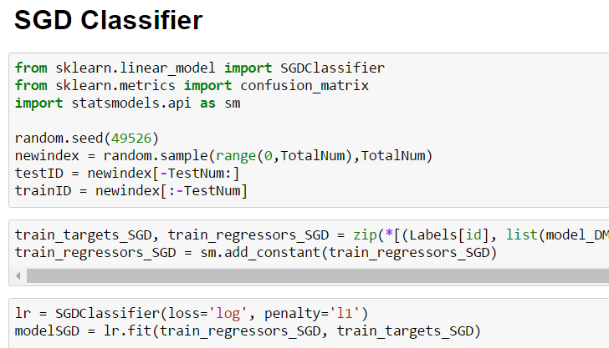
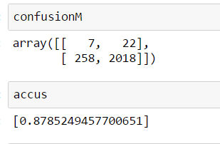
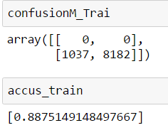
4) Applying Classification Algorithm
Testing
Training

Slide 18
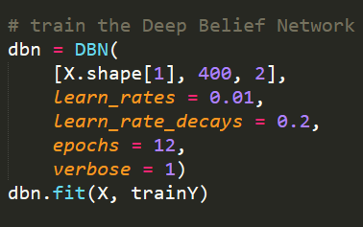
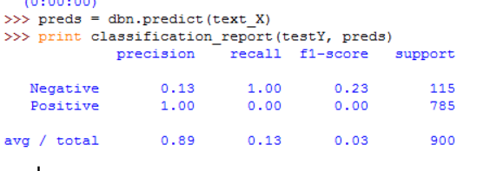
Deep Belief Network
Trained only on 3000 documents
Hyper parameters selected after 52 different combinations
In terms of learn_rates, decays, epochs and hidden units
Accuracy achieved of 89%

Slide 19
Conclusion
Deep Belief Network works well even with 3000 documents.
SVM performs poorly irrespective of the kernel and other hyper parameter
Best Model: Deep Belief Network

Slide 20
Challenges
Deep Belief Network does not work on Python 3
Need to setup Python 2.7.3 virtual environment
“nolearn” library compatibility issues
Python memory issues when working on large corpus. Does not work on CPU and needs a GPU powered machine

Slide 21
Thank You
References:
https://districtdatalabs.silvrback.com/modern-methods-for-sentiment-analysis
https://www.zybuluo.com/HaomingJiang/note/462804

